Slide 1

Digital forensics
Joakim Kävrestad Jönköping University joakim.kavrestad@ju.se
© Crown Copyright, The National Cyber Security Centre 2023. This information is licensed under the Open Government Licence v3.0. To view this licence, visit https://www.nationalarchives.gov.uk/doc/open-government-licence/version/3/.
When you use this information under the Open Government Licence, you should include the following attribution: CyBOK Digital forensics slides © Crown Copyright, The National Cyber Security Centre 2023, licensed under the Open Government Licence: https://www.nationalarchives.gov.uk/doc/open-government-licence/version/3/.

Slide 2
Agenda
Cyber in crime
Digital forensics
Forensic examination
Reporting
Autopsy demo

Slide 3
Literature note
This lecture is based on the following CyBOK knowledge areas:
Forensics

Slide 4
Cybercrime
A very common misconception is that computer forensic experts are working on cybercrimes.
That misconception makes it useful to discuss cybercrime and when digital evidence is useful in criminal investigations.
First, what constitutes a cybercrime is not really interesting on the topic of computer forensics. Computer forensics deals with digital evidence, and that is present in any type of crime.

Slide 5
Cybercrime
However, when discussing cybercrime one could argue that it is about crimes against computers, such as hacking attacks.
Rogers (2001) involved several types of criminals in his discussion on computer criminals, including hackers and fraudsters
Discussing crimes in terms of means motives and opportunity, as Rogers (2000), one could argue that a cybercrime is a crime where the means is computerized.

Slide 6
Cybercrime
Perhaps a more useful discussion would be to discuss crimes in terms of pure cybercrimes and computer-aided crimes.
Cybercrimes would involve crimes that are completely cyber, such as intrusions, denial of service, and so on
Computer-aided crimes would involve traditional crimes that are aided by computers, such as online frauds or online drug trade
Offline crimes would be acts that do not rely on or are aided by computers in any way
However, digital evidence can still play a role in any type of crime!

Slide 7
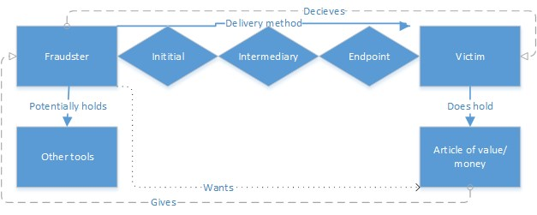
Example - (online) fraud

Slide 8
Cyber enabled and dependent crime
Modern terminology talks about cyber-enabled and dependent crime
Cyber-enabled crime is a traditional crime that utilizes cyber
Cyber-dependent crime is a crime that depends on cyber for its execution

Slide 9
REFLECT!
Use one minute to write down one-liners that describe what you just learned – come up with as many as you can.
Join up in pairs or groups and compare your lists for another minute.
Questions so far?

Slide 10
Digital forensics
The foundation of digital forensics is that it is the practice of collecting, analyzing, and reporting on digital data.
Combined, that is the process of a forensic examination
Implicit is that there is someone who is requesting the examination and that someone must have a reason for wanting the examination.
There is also someone who is examined, or whose devices are examined

Slide 11
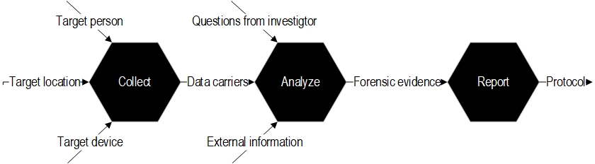
Digital forensics

Slide 12
Digital forensics – DFRWS definition
Digital forensics is the use of scientifically derived and proven methods toward the preservation, collection, validation, identification, analysis, interpretation, documentation and presentation of digital evidence derived from digital sources for the purpose of facilitating or furthering the reconstruction of events found to be criminal, or helping to anticipate unauthorised actions shown to be disruptive to planned operations.

Slide 13
Digital forensics – NIST definition
Digital forensics (NIST) is considered the application of science to the identification, collection, examination, and analysis of data while preserving the integrity of the information and maintaining a strict chain of custody for the data. Data refers to distinct pieces of digital information
that have been formatted in a specific way.

Slide 14
Digital forensics – CyBOK definition
Digital forensics is the process of identifying and reconstructing the relevant sequence of events that have led to the currently observable state of a target IT system or
(digital) artifacts.

Slide 15
Digital forensics
Forensics is about reconstructing what happened in a digital environment
Forensics is also extended to analyze what is currently happening
Computer forensics is used in law enforcement as well as in corporate environments
Crime investigations
Civil cases
Intrusion detection/response
misc.

Slide 16
Digital forensics
Digital forensics is about uncovering what has been done using a digital device or what happened to it.
includes uncovering what is stored on the actual device
track internet history such as browsing and chat history
Analyze who authored a document or where a picture was taken
Identify information about intrusions.
Basically, everything done with a digital device will leave prints that a skilled forensic expert can uncover.

Slide 17
Digital evidence
Digital forensics is about examining digital evidence
Data of evidentiary value is commonly referred to as artifacts
Digital evidence is data collected from digital storage that is subject to a forensic examination.
From a technical viewpoint, the evidence-collection process can be divided into handling devices that are on and devices that are off.
Dead box analysis vs. Live forensics

Slide 18
Digital evidence
Whenever handling evidence, especially in law enforcement, it is of extreme importance that the state of the evidence is not changed
The evidence must be accepted by courts
In computer forensics this means that the content of the storage media must not be changed at all.
Since all computer usage will almost certainly leave traces and can thus modify the data on the storage device, actions must be taken to prepare a device for secure examination.

Slide 19
Digital evidence
Before an analysis can start, digital evidence must fall into the hand of the examiner
Most common case is that a device arrives, seized and turned off
Dead box analysis
In some cases, the examiner gets the chance to start the examination from a running machine
Live forensics

Slide 20
Types of digital evidence
Files and folders
What You See Is What You Get
Deleted files which can be recovered
Settings and logs
Log files in various formats
Windows registry
Metadata
Data describing other data
Time stamps, permissions, etc

Slide 21
Dead box analysis
Connect the storage device of the target computer to your own computer using a write blocker.
A write blocker prohibits your computer from writing data to the device and can be a software or a hardware device
Create a forensic disk image of the device
A physical disk image is a bit-by-bit copy of the device
A logical disk image is a copy of one or more full partitions as seen by the operating system
Work your case by analyzing the forensic disk image
If it is impossible to create an image, you will need to work on the actual drive. You may even be forced to conduct the examination on the actual computer that is subject for examination. In these cases, it is important that you understand that your actions can contaminate the evidence. Take careful notes!

Slide 22
Live forensics
Live forensics is about examining devices that are on.
Live examinations introduces considerations regarding the integrity of the evidence. However, it allows you to collect volatile data:
Document what is currently on screen
Information about the current user, current network connections etc.
Memory dump
Analyze if any encryption software is used, do malware analysis etc.
The power of the memory analysis is that evil actions must be in their true form as far as low-level instructions go.
After the Live examination, the computer is often brought to the lab for dead box analysis

Slide 23
REFLECT!
Use one minute to write down one-liners that describe what you just learned – come up with as many as you can.
Join up in pairs or groups and compare your lists for another minute.
Questions so far?

Slide 24
Analysis
A forensic examination is about answering questions asked by someone else. The common idea is to uncover what the computer has been used for, or what happened to it in order to prove or disprove something.
Malware/incident detection
Attribution
A forensic examination must be
Unbiased
Reproducible
Comply with local laws and regulations.
In a corporate environment, the requirements may be more loose

Slide 25
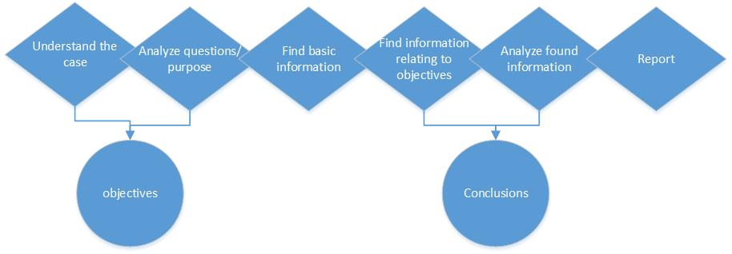
Analysis

Slide 26
Analysis
Before you get going, you should spend some time understanding the case and the objectives handed to you to understand what you are asked to look for.
This can involve:
Reading case description
Reading interrogation reports
Reading IDS logs
Questioning users
The result should be objectives describing what to look for during the examination

Slide 27
Analysis – basic information examples
Account for all data, meaning that you examine the physical size of the hard drive and then look at how much of this space is allocated to a visible partition.
Get the computer install date, operating system version, list of users, and registered owner so that you can easily answer questions about what operating system the computer used, how many users there were on the system, and so on.
Get time zone information and clock settings for the sole reason that time is commonly an important factor.
Find network drive maps so that you can know if the computer has been connected to remote storage media.

Slide 28
Analysis
Look for artifacts concerning the objectives of your examination
Analyze the artifacts that you found and use this information to draw conclusions.
You may include external information when you draw conclusions
Summarize your findings and conclusions in a report, this is discussed next.
In incident response, it is common to go directly to the analysis for time purposes

Slide 29
REFLECT!
Use one minute to write down one-liners that describe what you just learned – come up with as many as you can.
Join up in pairs or groups and compare your lists for another minute.
Questions so far?

Slide 30
Reporting
Your findings should be presented in a report.
Reflect a fair and objective view of your examination
The local laws and regulations will dictate the content and format of the report.
It is common that the report will be read by persons who are not computer experts – use appropriate language.

Slide 31
Reporting – typical content
Case data
Data such as case identifiers and evidence identifiers
Purpose of examination
Description of the objectives of the examination
Findings
The artifacts found during the examination
Conclusions
Your conclusions which are based on the examination. Clearly separated from the findings and written with a common scale.

Slide 32
Autopsy
Open source computer forensics tool
Allows you to view and process digital evidence
View as in browsing in different ways
Process as in automatically perform various analysis tasks
Let’s have a look!

Slide 33
Thank you for today!

